Slide 1
Lecture 2 - Concurrency and Multithreading

Slide 2
Outline
Appreciate the (increasing) importance of parallel programming
Understand fundamental concepts:
  Parallelism, threads, multi-threading, concurrency, locks, etc.
See some basics of this is done in Java
See some common uses:
  Divide and conquer, e.g. mergesort
  Worker threads in Swing

Slide 3
Background
An area of rapid change!
  1990s: parallel computers were $$$$
  Now: 4 core machines are commodity
Variations between languages
Evolving frameworks, models, etc.
  E.g. Java’s getting Fork/Join since Java 1.7
  MAP/REDUCE

Slide 4
(Multi)Process vs (Multi)Thread
Assume a computer has one CPU
Can only execute one statement at a time
  Thus one program at a time
Process: an operating-system level “unit of execution”
Multi-processing
  Op. Sys. “time-slices” between processes
  Computer appears to do more than one program (or background process) at a time
Notes:
Show “top” command running in shell in OS X or Unix.

Slide 5
Multicore vs Multithreading
Modern CPUs have multiple cores that can execute multiple processes at the same time
Multiple threads can run even in a single core CPU
Multithreading can utilize the multiple cores
Still, it is the job of the operating system to schedule and run the parallel tasks

Slide 6
Advantages of Multithreading
Reactive systems – constantly monitoring
More responsive to user input – GUI application can interrupt a time-consuming task
Server can handle multiple clients simultaneously
Can take advantage of parallel processing

Slide 7
Multithreading
Different processes do not share memory space.
A thread can execute concurrently with other threads within a single process.
All threads managed by the JVM share memory space and can communicate with each other.

Slide 8

Threads Concept
Multiple threads on multiple CPUs
Multiple threads sharing a single CPU

Slide 9
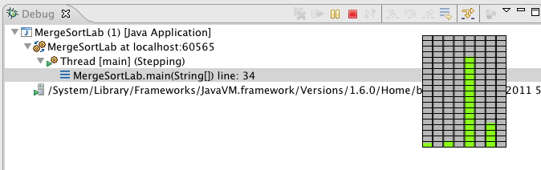
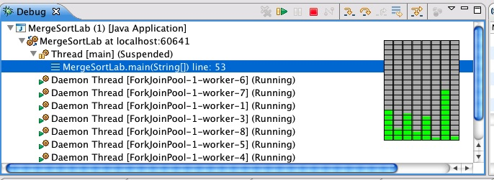
Screenshots: For single- and multi-threaded Mergesort:
Threads in Eclipse Debug window, and Mac’s CPU usage display
text

Slide 10
Tasks and Threads
Thread: “a thread of execution”
  “Smaller”, “lighter” than a process
  smallest unit of processing that can be scheduled by an operating system
  Has its own run-time call stack, copies of the CPU’s registers, its own program counter, etc.
  Process has its own memory address space, but threads share one address space
A single program can be multi-threaded
  Time-slicing done just like in multiprocessing
  Repeat: the threads share the same memory

Slide 11
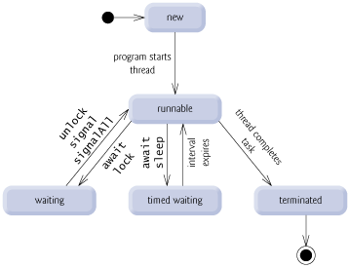
Thread States

Slide 12
Task
A task is an abstraction of a series of steps
  Might be done in a separate thread
  Parallelizable
In Java, there are a number of classes / interfaces that basically correspond to this
  Example (details soon): Runnable
    work done by method run()

Slide 13
Java: Statements → Tasks
Consecutive lines of code:
Foo tmp = f1;
f1 = f2;
f2 = tmp;
A method:
swap(f1, f2);
A “task” object:
SwapTask task1= new SwapTask(f1,f2);
task1.run();

Slide 14
Why a task object?
Actions, functions vs. objects. What’s the difference?

Slide 15
Why a task object?
Actions, functions vs. objects. What’s the difference?
Objects:
  Are persistent. Can be stored.
  Can be created and then used later.
  Can be attached to other things. Put in Collections.
  Contain state.
Functions:
  Called, return (not permanent)

Slide 16
Java Library Classes for Concurrency
For task-like things:
  Runnable, Callable
  SwingWorker, RecursiveAction, etc.
Thread class
Managing tasks and threads
  Executor, ExecutorService
  ForkJoinPool
In Swing
  The Event-Dispatch Thread
  SwingUtilities.invokeLater()

Slide 17
Java Thread Classes and Methods
Java has some “primitives” for creating and using threads
  Most sources teach these, but in practice they’re hard to use well
  Now, better frameworks and libraries make using them directly less important.
But let’s take a quick look

Slide 18
Java’s Thread Class
Class Thread: it’s method run() does its business when that thread is run
But you never call run(). Instead, you call start() which lets Java start it and call run()
To use Thread class directly (not recommended now):
  define a subclass of Thread and override run() – not recommended!
  Create a task as a Runnable, link it with a Thread, and then call start() on the Thread.
    The Thread will run the Runnable’s run() method.

Slide 19
Creating a Task and Thread
Again, the first of the two “old” ways
Get a thread object, then call start() on that object
  Makes it available to be run
  When it’s time to run it, Thread’s run() is called
So, create a thread using inheritance
  Write class that extends Thread, e.g. MyThread
  Define your own run()
  Create a MyThread object and call start() on it
Not good design!

Slide 20
Runnables and Thread
Use the “task abstraction” and create a class that implements Runnable interface
  Define the run() method to do the work you want
Now, two ways to make your task run in a separate thread
  First way:
    Create a Thread object and pass a Runnable to the constructor
    As before, call start() on the Thread object
  Second way: hand your Runnable to a “thread manager” object

Slide 21
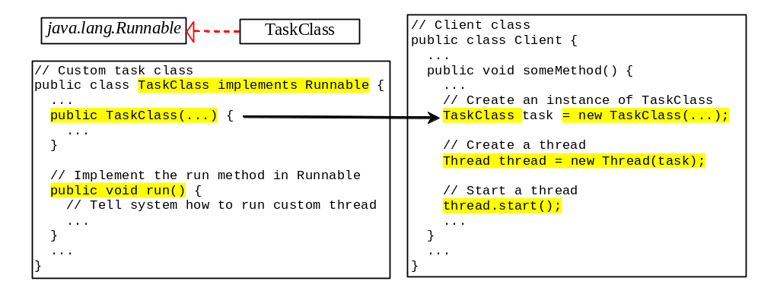
Creating Tasks and Threads

Slide 22
Join
The Thread class defines various primitive methods you could not implement on your own
  For example: start, which calls run in a new thread
The join() method is one such method, essential for coordination in this kind of computation
  Caller blocks until/unless the receiver is done executing (meaning its run returns)
  E.g. in method foo() running in “main” thread, we call:
  myThread.start(); myThread.join();
  Then this code waits (“blocks”) until myThread’s run() completes
This style of parallel programming is often called “fork/join”
  Warning: we’ll soon see a library called “fork/join” which simplifies things. In that, you never call join()

Slide 23
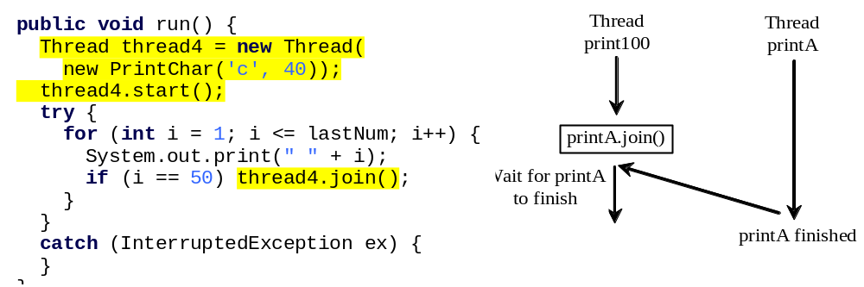
Join

Slide 24
Threading in Swing
Threading matters a lot in Swing GUIs
  You know: main’s thread ends “early”
  JFrame.setvisible(true) starts the “GUI thread”
Swing methods run in a separate thread called the Event-Dispatching Thread (EDT)
  Why? GUIs need to be responsive quickly
  Important for good user interaction
But: slow tasks can block the EDT
  Makes GUI seem to hang
  Doesn’t allow parallel things to happen

Slide 25
Thread Rules in Swing
All operations that update GUI components must happen in the EDT
  These components are not thread-safe (later)
  SwingUtilities.invokeLater(Runnable r) is a method that runs a task in the EDT when appropriate
But execute slow tasks in separate worker threads
To make common tasks easier, use a SwingWorker task

Slide 26
SwingWorker
A class designed to be extended to define a task for a worker thread
  Override method doInBackground()
  This is like run() – it’s what you want to do
  Override method done()
  This method is for updating the GUI afterwards
    It will be run in the EDT
Note you can get interim results too

Slide 27
Java ForkJoin Framework
Designed to support a common need
  Recursive divide and conquer code
  Look for small problems, solve without parallelism
  For larger problems
    Define a task for each subproblem
    Library provides
      a Thread manager, called a ForkJoinPool
      Methods to send your subtask objects to the pool to be run, and your call waits until their done
      The pool handles the multithreading well

Slide 28
The ForkJoinPool
The “thread manager”
  Used when calls are made to RecursiveTask’s methods fork(), invokeAll(), etc.
  When created, knows how many processors are available
  Pretty sophisticated
    “Steals” time from threads that have nothing to do

Slide 29
Overview of How To
Create a ForkJoinPool “thread-manager” object
Create a task object that extends RecursiveTask
  Create a task-object for entire problem and call
  invoke(task) on your ForkJoinPool
Your task class’ compute() is like Thread.run()
  It has the code to do the divide and conquer
  First, it must check if small problem – don’t use parallelism, solve without it
  Then, divide and create >1 new task-objects. Run them:
    Either with invokeAll(task1, task2, …). Waits for all to complete.
    Or calling fork() on first, then compute() on second, then join()

Slide 30
Same Ideas as Thread But...
To use the ForkJoin Framework:
A little standard set-up code (e.g., create a ForkJoinPool)
Don’t subclass Thread Do subclass RecursiveAction<V>
Don’t override run Do override compute
Don’t call start Do call invoke, invokeAll, fork
Don’t just call join Do call join which returns answer
or
Do call invokeAll on multiple tasks

Slide 31
Mergesort Example
Top-level call. Create “main” task and submit
public static void mergeSortFJRecur(Comparable[] list, int first,
int last) {
if (last - first < RECURSE_THRESHOLD) {
MergeSort.insertionSort(list, first, last);
return;
}
Comparable[] tmpList = new Comparable[list.length];
threadPool.invoke(new SortTask(list, tmpList, first, last));
}

Slide 32
Mergesort’s Task-Object Nested Class
static class SortTask extends RecursiveAction {
Comparable[] list;
Comparable[] tmpList;
int first, last;
public SortTask(Comparable[] a, Comparable[] tmp,
int lo, int hi) {
this.list = a; this.tmpList = tmp;
this.first = lo; this.last = hi;
}
// continued next slide

Slide 33
compute() Does Task Recursion
protected void compute() { // in SortTask, continued from previous slide
if (last - first < RECURSE_THRESHOLD)
MergeSort.insertionSort(list, first, last);
else {
int mid = (first + last) / 2;
// the two recursive calls are replaced by a call to invokeAll
SortTask task1 = new SortTask(list, tmpList, first, mid);
SortTask task2 = new SortTask(list, tmpList, mid+1, last);
invokeAll(task1, task2);
MergeSort.merge(list, first, mid, last);
}
}

Slide 34
Nice to Have a Thread “Manager”
If your code is responsible for creating a bunch of tasks, linking them with Threads, and starting them all, then you have muchto worry about:
  What if you start too many threads? Can you manage the number of running threads?
  Enough processors?
  Can you shutdown all the threads?
  If one fails, can you restart it?

Slide 35
Executors
An Executor is an object that manages running tasks
  Submit a Runnable to be run with Executor’s execute() method
  So, instead of creating a Thread for your Runnable and calling start() on that, do this:
    Get an Executor object, say called exec
    Create a Runnable, say called myTask
    Submit for running: exec.execute(myTask)

Slide 36
How to Get an Executor
Use static methods in Executors library.
Fixed “thread pool”: at most N threads running at one time
Executor exec =
Executors.newFixedThreadPool(MAX_THREADS);
Unlimited number of threads
Executor exec =
Executors.newCachedThreadPool();

Slide 37
Summary So Far
Create a class that implements a Runnable to be your “task object”
  Or if ForkJoin framework, extend RecursiveTask
Create your task objects
Create an Executor
  Or a ForkJoinPool
Submit each task-object to the Executor which starts it up in a separate thread

Slide 38
Concurrency and Synchronization
Concurrency:
Multiple-threads/Processes accessing shared data
Synchronization:
Methods to manage and control concurrent access to shared data by multiple-threads

Slide 39
Possible Bugs in Multithreaded Code
Possible bug #1
i=1; x=10; x = i + x; // x could be 12 here
Possible bug #2
if ( ! myList.contains(x) )
myList.add(x); // x could be in list twice
Why could these cause unexpected results?

Slide 40
How 1 + 10 might be 12
Thread 1 executes:
  (x is 10, i is 1)
  Get i (1) into register 1
  Get x (10) into its register 2
  (other thread has CPU)
  Add registers
  Store result (11) into x
  (x is now 11)
  (other thread has CPU)
  (other thread has CPU)
  Do next line of code
  (x changes to 12 even though
  no code in this thread has
  touched x)
Thread 2 executes:
  (x is 10, i is 1)
  (other thread has CPU)
  (other thread has CPU)
  Get i (1) into its register 1
  (other thread has CPU)
  (other thread has CPU)
  Get x (11) into is register 2
  Add registers
  Store result (12) into x
  (x is now 12)

Slide 41
Synchronization
Understand the issue with concurrent access to shared data?
  Data could be a counter (int) or a data structure (e.g. a Map or List or Set)
A race condition: Two threads will access something. They “compete” causing a problem
A critical section: a block of code that can only be safely executed by one thread at a time
A lock: an object that is “held” by one thread at a time, then “released”

Slide 42
Synchronized Methods
Common situation: all the code in a method is a critical section
  I.e. only one thread at a time should execute that method
  E.g. a getter or setter or mutator, or something that changes shared state info (e.g. a Map of important data)
Java makes it easy: add synchronized keyword to method signature. E.g.
public synchronized void update(…) {

Slide 43
public class Counter {
  private int counter;
  public synchronized void increment() {
  counter++;
  }
  public int read() {
  return counter;
  }
  }

Slide 44
Synchronization using Locks
Any object can serve as a lock
  Separate object: Object myLock = new Object();
  Current instance: the this object
Enclose lines of code in a synchronized block
synchronized(myLock) {
// code here
}
More than one thread could try to execute this code, but one acquires the lock and the others “block” or wait until the first thread releases the lock
More fine grained than method synchronization (more prone to errors)

Slide 45
Summary So Far
Concurrent access to shared data
  Can lead to serious, hard-to-find problems
  E.g. race conditions
The concept of a lock
Synchronized blocks of code or methods
  One thread at a time
  While first thread is executing it, others block

Slide 46
Some Java Solutions
There are some synchronized collections
Classes like AtomicInteger
  Stores an int
  Has methods to operate on it in a thread-safe manner
    int getAndAdd(int delta) instead of i=i+1

Slide 47
Volatile keyword
Compilers cache variable values from the memory in the registers for faster performance
This can sometimes lead to errors in execution in a multithreaded program
Volatile keyword ensures that each variable update is visible to all threads
However, it does not ensure atomicity of operations (which has to be handled separately)

Slide 48
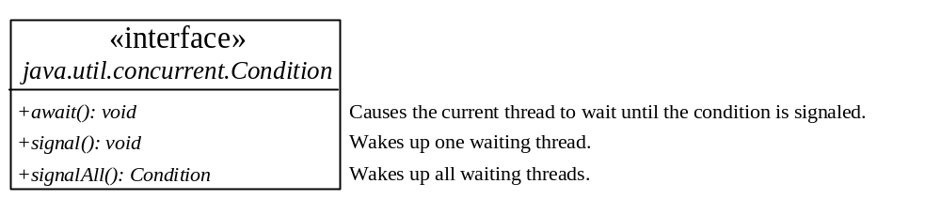
Cooperation/Communication Among Threads
Conditions can be used for communication among threads.
A thread can specify what to do under a certain condition.
newCondition() method of Lock object.
Condition methods:
  await() current thread waits until the condition is signaled
  signal() wakes up a waiting thread
  signalAll() wakes all waiting threads

Slide 49
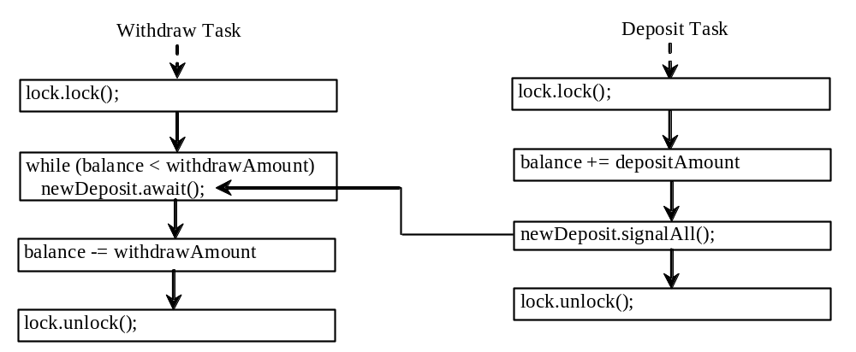
Cooperation Among Threads
Lock with a condition to synchronize operations: newDeposit
If the balance is less than the amount to be withdrawn, the withdraw task will wait for the newDeposit condition.
When the deposit task adds money to the account, the task signals the waiting withdraw task to try again.
Interaction between the two tasks:

Slide 50
Monitor objects
A monitor is an object with mutual exclusion and synchronization capabilities.
Only one thread can execute a method at a time in the monitor.
A thread enters the monitor by acquiring a lock (synchronized keyword on method / block) on the monitor and exits by releasing the lock.
A thread can wait in a monitor if the condition is not right for it to continue executing in the monitor.
Any object can be a monitor. An object becomes a monitor once a thread locks it.

Slide 51
wait(), notify(), and notifyAll()
Use the wait(), notify(), and notifyAll() methods to facilitate communication among threads.
The wait(), notify(), and notifyAll() methods must be called in a synchronized method or a synchronized block on the calling object of these methods. Otherwise, an IllegalMonitorStateException would occur.
The wait() method lets the thread wait until some condition occurs. When it occurs, you can use the notify() or notifyAll() methods to notify the waiting threads to resume normal execution. The notifyAll() method wakes up all waiting threads, while notify() picks up only one thread from a waiting queue.

Slide 52
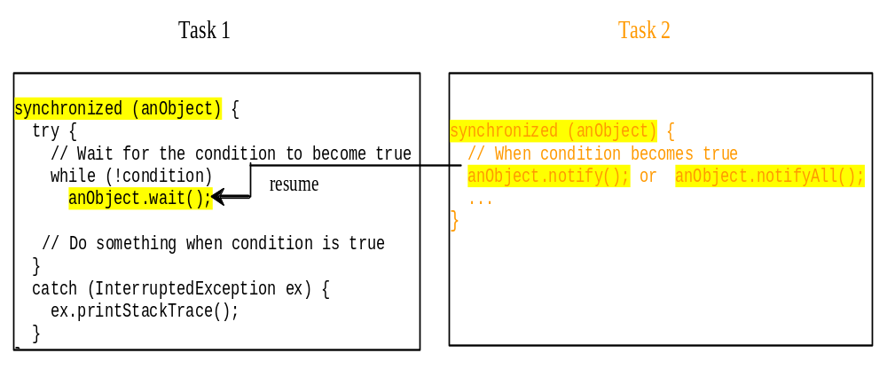

Example: Using Monitor

Slide 53
Interrupting threads
Interrupt()
If a thread is currently in the Ready or Running state, its interrupted flag is set; if a thread is currently blocked, it is awakened and enters the Ready state, and an java.io.InterruptedException is thrown.
The isInterrupt() method tests whether the thread is interrupted.
Can be used to gracefully stop a waiting thread

Slide 54
class TestInterruptingThread1 extends Thread{
public void run(){
try{
Thread.sleep(1000);
System.out.println("task");
}catch(InterruptedException e){
throw new RuntimeException("Thread interrupted..."+e);
}
}
public static void main(String args[]){
TestInterruptingThread1 t1=new TestInterruptingThread1();
t1.start();
try{
t1.interrupt();
}catch(Exception e){System.out.println("Exception handled "+e);}
}
}

Slide 55
The Static sleep(milliseconds) Method
The sleep(long mills) method puts the thread to sleep for the specified time in milliseconds
  public void run() {
  for (int i = 1; i <= lastNum; i++) {
  System.out.print(" " + i);
  try {
  if (i >= 50) Thread.sleep(1);
  }
  catch (InterruptedException ex) {
  }
  }
  }
Every time a number (>= 50) is printed, the print100 thread is put to sleep for 1 millisecond.

Slide 56
More Advanced Synchronization
A semaphore object
  Allows simultaneous access by N threads
  If N==1, then this is known as a mutex (mutual exclusion)
  Java has a class Semaphore

Slide 57
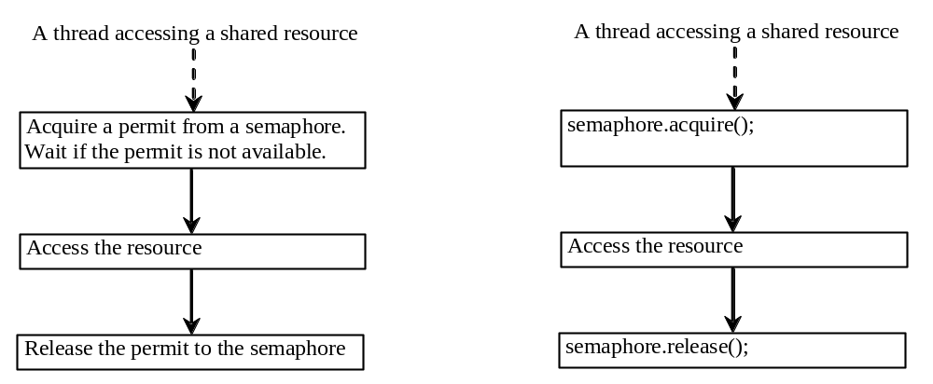
Semaphores
Semaphores can be used to restrict the number of threads that access a shared resource.
There is no notion of ‘ownership’ in Semaphores (unlike ‘locks’)

Slide 58
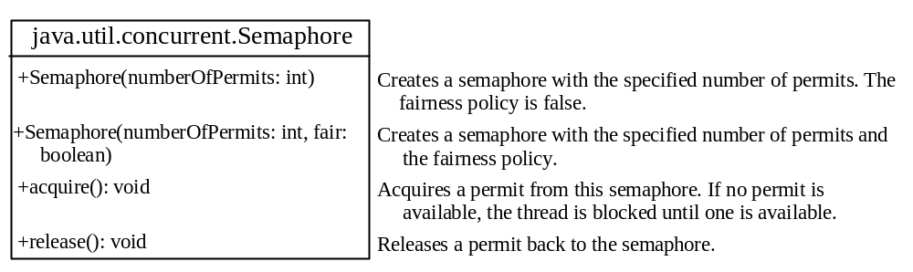
Creating Semaphores
To create a semaphore, you have to specify the number of permits with an optional fairness policy
Once a permit is acquired, the total number of available permits in a semaphore is reduced by 1.
Once a permit is released, the total number of available permits in a semaphore is increased by 1.

Slide 59
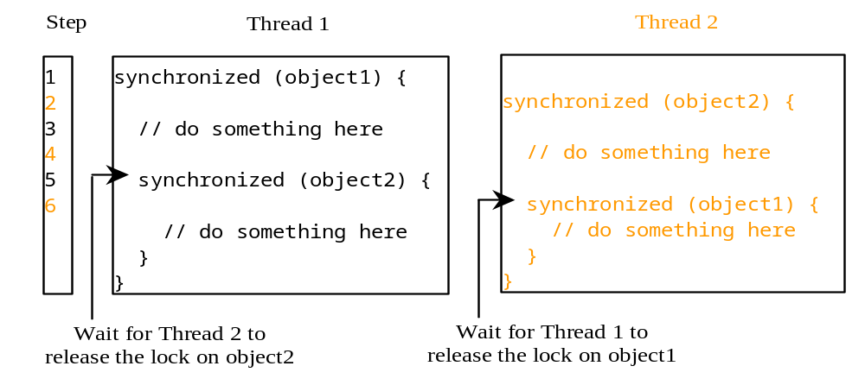
Deadlock
Sometimes two or more threads need to acquire the locks on several shared objects.
This could cause deadlock, in which each thread has the lock on one of the objects and is waiting for the lock on the other object.
In the figure below, the two threads wait for each other to release the in order to get a lock, and neither can continue to run.

Slide 60
Preventing Deadlocks
Deadlock can be easily avoided by resource ordering.
With this technique, assign an order on all the objects whose locks must be acquired and ensure that the locks are acquired in that order.
How does this prevent deadlock in the previous example?

Slide 61
Summary
Volatile variables are used to avoid synchronization issues due to caching of variables
Monitors can be used for inter-thread communication
Interrupts are used to gracefully stop threads
Sleep() operation is used to suspend a thread for a specified time
Semaphores control the access to a shared object
Ordering of locks can avoid deadlocks

